Slide 1


Data Science Jobs and Salaries Analysis
2020-2023
Nate Reedel
GitHub https://github.com/NReedel/OESON/tree/main/Project02

Slide 2

2023 Data
Using visual representation of collected table data, we can understand the financial salary for a collection of jobs and begin to derive relevant insights from them.
Table data to be compared includes: job category, different salary types, employee data, and company data,

Slide 3

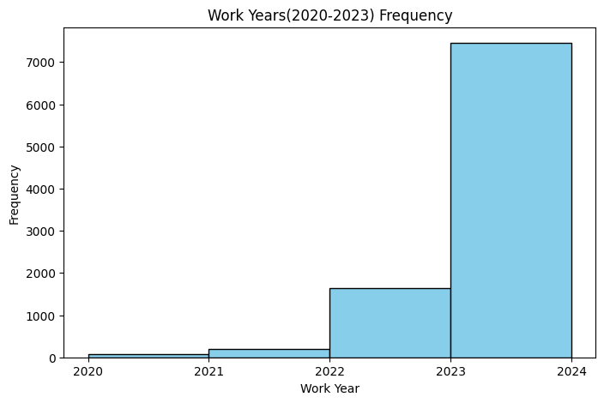
Frequency of each year
Over the past 4 years, sample data from jobs and salaries has followed a relatively exponential growth pattern.
This means more accurate data has come from more recent data as it enforced by a larger sample size.

Slide 4
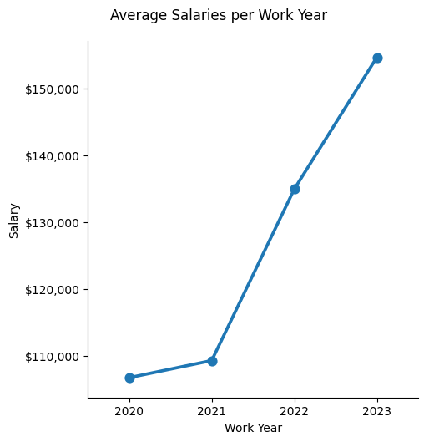
Average Salaries for each year
Each year, the average salary increases.
This shows overall economic growth patterns for the employes and likely the companies that hired them as well.

Slide 5
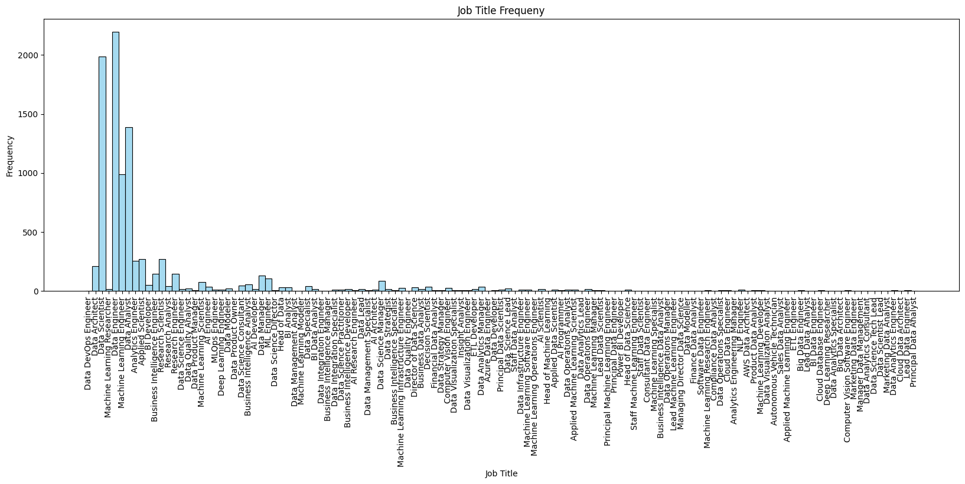
Frequency of Job Titles
The most frequent occurring job titles include Data Engineer, Data Scientist, Data analyst, and Machine Learning engineer. This indicates that these are the most sought positions filled by employers.
Other Jobs are significantly lower by comparison. Overall appearing to be more specific, niche titles that have little openings or are harder to fill jobs for.

Slide 6
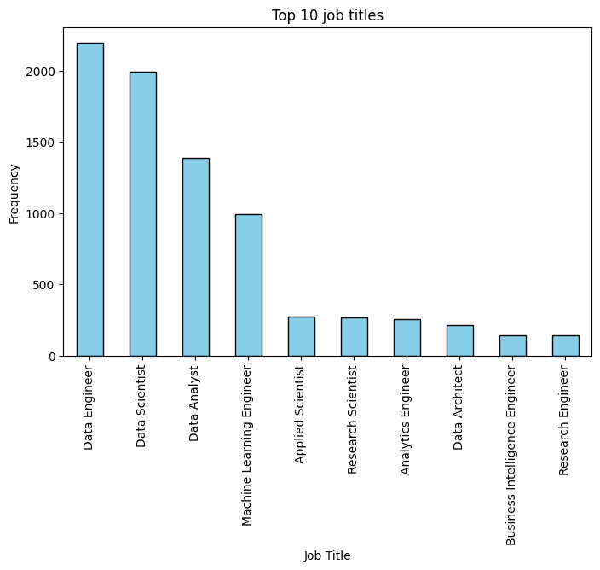
Top 10 most common data jobs
Taking a closer look at the top ten of the previous slide…
Once more, we see that the top 4 jobs are significantly more frequent, and all revolve around data positions. This likely indicates that data engineer, scientist, and analyst jobs are highly sought.
The other Science, Engineering and Architect jobs shown are significantly less occurring and average similar frequencies.
Data Architect doesn’t follow the same trend as other direct data-based positions. Which may be because it is a more specific job with few positions or possibly just an outlier.

Slide 7
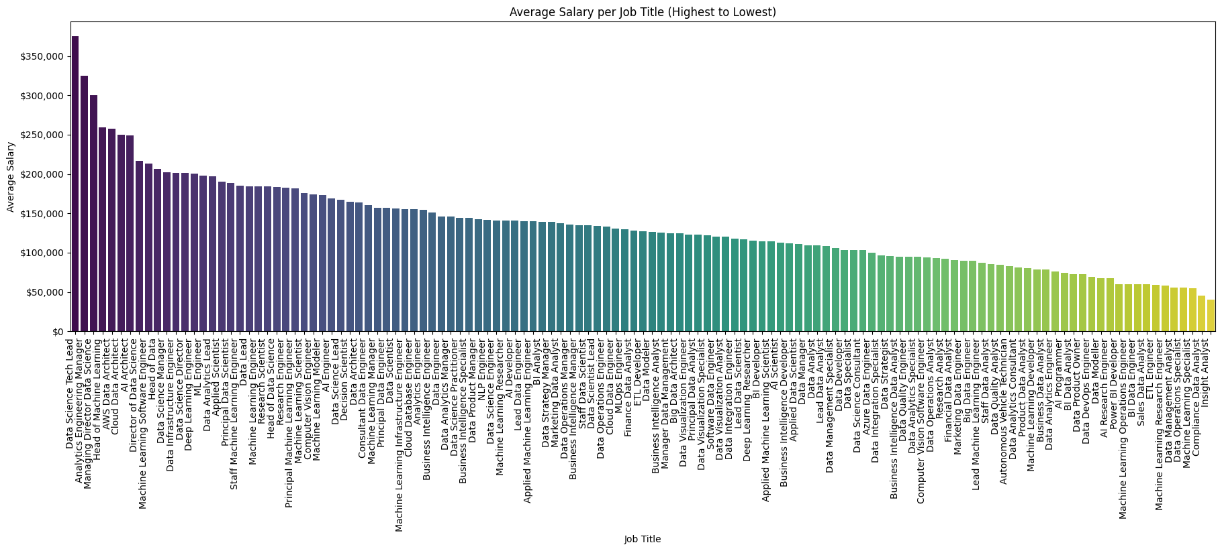
Job title average salaries (high to low)
Top 7 average salary are outliers significantly higher salaries than the rest, having greater variation.
The rest are comparatively lower by comparison
Overall the average salary for these jobs appear more evenly distributed with few outliers and a steady linear decline.

Slide 8
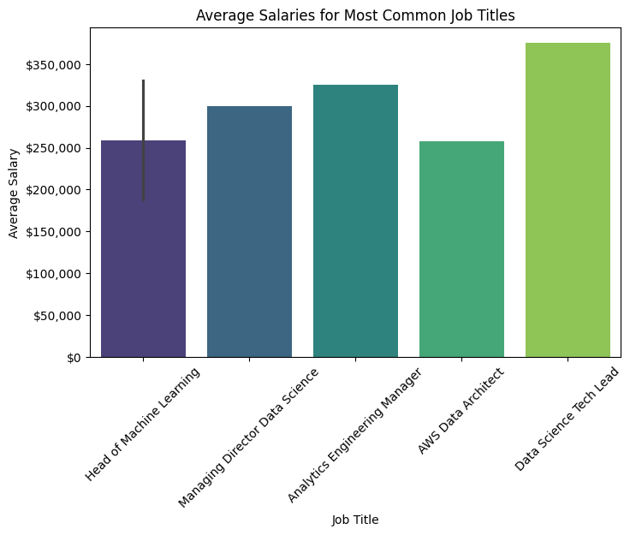
Average Salary for the most common job titles
Taking a closer look at the top 5 average job salaries…
Data Science Tech Lead, the highest paying. Analytics Engineering Manager, and Managing Director Data Science.
All high salary jobs are head, lead, management or require an AWS certification.
This shows naturally that Senior and Executive positions pay more as they levy more responsibilities and knowledge. With data science tech lead being the highest paying over $350,000 a year
Interestingly, none of these jobs had a high frequency(shown 3 slide back) and so likely have few positions filled.

Slide 9
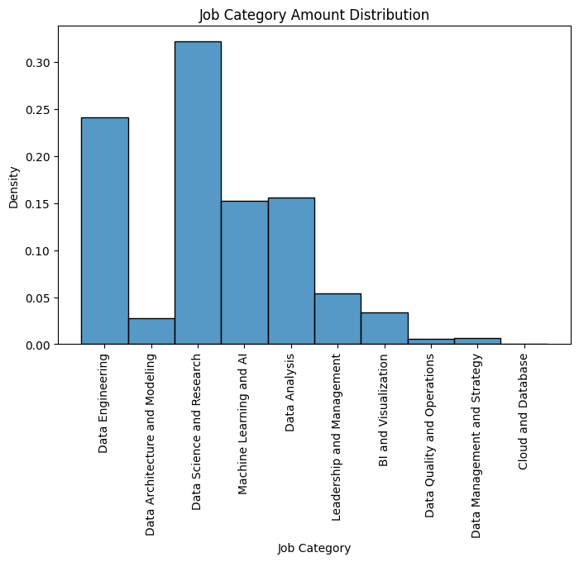
Distribution of job Categories
Most of values are significantly different based on the 10 different categories, meaning these job categories don’t have a normal distribution due to extremities.
The highest density distribution of Job Categories is Data Science and Research, indicating the mode of job categories. This shows it has the most positions occupied by data science-based jobs.
Cloud and Database has the almost no density, occurring the least frequently and acts as an outlier. So it has almost no data science job positions filled.

Slide 10
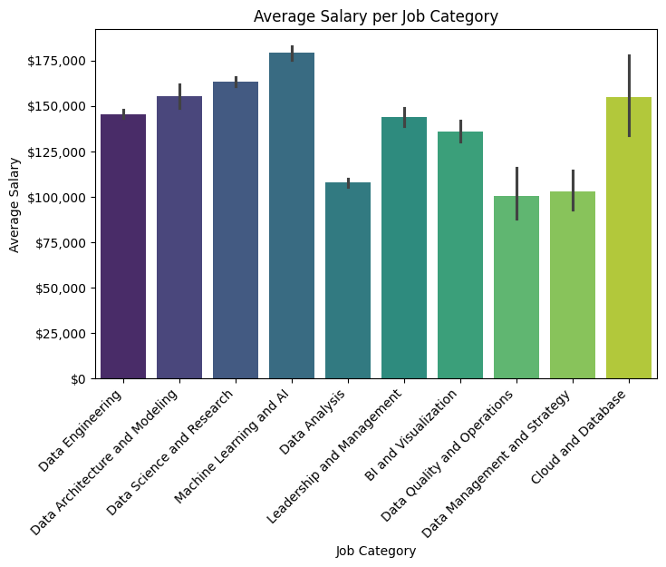
Average Salary per Job Category
The highest average salary belongs to the machine learning job category. With low to average variation, this is a good job position for workers to fill you want to earn a higher income.
Cloud & Data base is higher than other categories for its average salary. The category notably has the highest range of possible salaries, with the max being comparable to the highest. So this is a well paying, desirable position as well.
The lowest and therefore less desirable job category salary is for Data Quality and Operations, though it does offer the 2nd largest variation of salaries, overall its still worse paying than any other option.

Slide 11
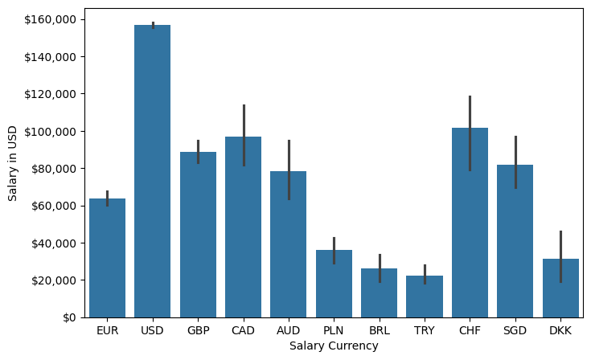
Average salary in usd based on currency
The average salary in USD compared to other salaries is the USD itself, which isn’t surprising as it typically act as a global standard of money. Its variability of value is significantly smaller which shows consistency within its own currency.
The CHF or Swiss Frank currency is average compared to the others but has the greatest variation in value, this highlights the largest variation of salaries for data based jobs.
The TRY or Turkish Lira, pays the lowest salary in terms of U.S. dollar and has an average variation.

Slide 12
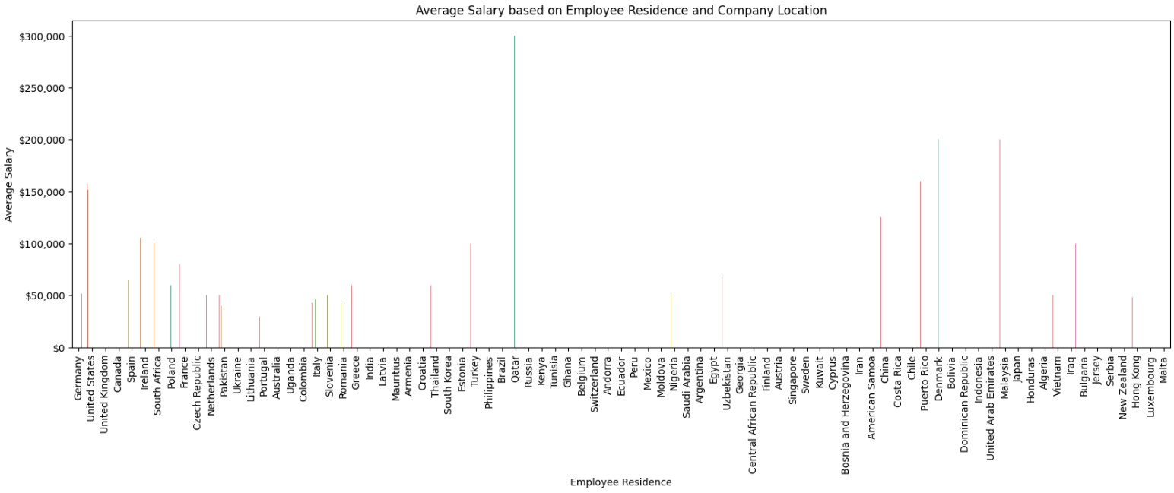
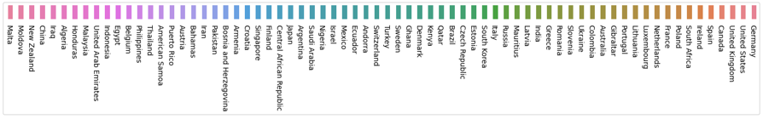
Average salary using employee residence and company location
Interestingly the Highest Avg salary, over $300,000, based on employee residence & company location, both Qatar, a country in the Arabian Peninsula.
Most other countries have little to no salary listed and so this chart can be used to determine areas with job opportunity, what pay level you may expect, and where to avoid.

Slide 13
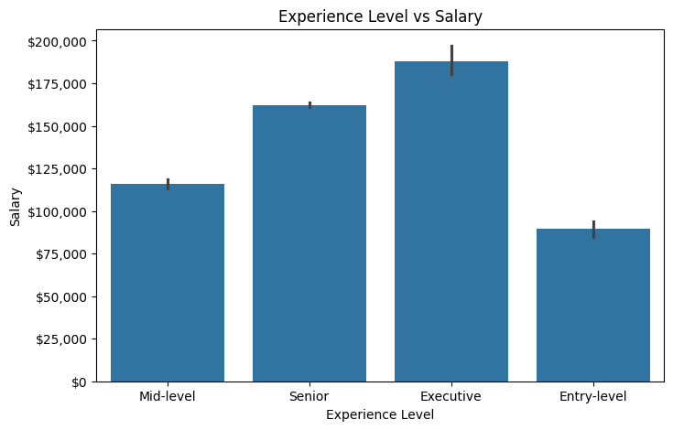
Salary based on experience level
This chart shows a somewhat obvious trend, that entry level data jobs get lower salaries and executive get the highest
Mid-level to Senior position shows the greatest avg increase in salary rate therefore incentives earning a promotion the most.
Senior to executive shows the least avg increase in salary so likely has the least motivation for promotion.

Slide 14
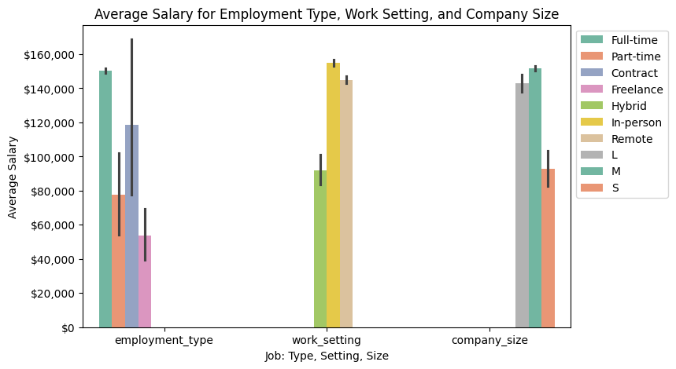
Average salary based on employment type, work setting and company size
The best and most consistent employment type is full time. The next highest pay is contract. It has a large range of variation but even at its minimum value its still the second highest on average and even greater than full time at its max.
In person has the highest salary but remote has become more prominent over the years with has become a close secondary. Hybrid work on the other hand has considerably lower salary in comparison to the others and may seen as a less wanted job.
A medium company size has the highest paying salary, likely because there willing to invest money for the sake of more growth and production. Large companies are a close 2nd but probably have more lower salary positions since they already have established high paid workers and are looking to cut costs. Small companies pay significantly less as they have limited resources and need to grow before employees get paid more.

Slide 15
Summary
There's a lot of information derived from these stats and visualizations.
Insights about data jobs and how they pay depending on factors like location, position, category, currency, and company type have been reviewed and provided some useful information. Hopefully, you now have a decent understanding of its market and can make an informed opinion from it.

Slide 16
Conclusion
Though this is just a brief analysis on a finite sample size, we have at least breached the surface on statistics of a specified market.
More research is always an option. I encourage anyone interested in this type of analysis to find more sample data, make comparisons on the graphs shown in this presentation to draw more in-depth deductions or to even do their own research charts in different job fields.

